Slide 1
Team INT ELLIGENCE
Team Members
Akash Sinha
Tanvi Tembhurne
Anuradha Choudhary

Slide 2
Problem Statement
In USA millions of children suffer from obesity, depression, anxiety, stress,
ADHD or a host of other mental health issues. These issues are leading to
suicides in younger teenagers.
Suicide is the third leading cause of death of individuals aged from 10 to 14.
Sporadically, children are deprived of their parent’s attention because of
their parent’s busy schedule.
Our aim of the application is to detect these behaviors of children early in
their life by performing regular medical camps in the schools that are organized
by State run hospitals

Slide 3
Approach following
The Nurse in Medical Booth will do the basic check up on students(patients) and will report to Doctor in Medical Camp
The Nurse can admit patients to the Camp Medical Room if needed.
The Nurse can also request the following to the Medical Drive Manager alerted via email too:
Beds 2. Apply Leave
In case of Emergencies the nurse can directly contact the Doctors at the Medical Camps:
Extra Medical Staff 2. Beds
The Medical Drive Manager will further send requests to Medical Camp Doctors or food Suppliers:
Relieving Nurse 2. Medical Supplies for the Camp 3. Moving patients to Medical Camp
They are also responsible for requesting Food Supplies from Food Supplier and managing the Camps Food Inventory.
The Doctor will process all the request forwarded by Medical Drive Manager and emergency requests forwarded by Nurse.
Doctor is also responsible for managing the inventory for medical supplies and request the same from medical suppliers.
The Food Suppliers addresses the requests from Medical Drive Manager and Supplies items from their own Inventory.
The Medical Suppliers addresses the requests from Doctors and Supplies items from their own Inventory.

Slide 4
Flow
School
Medical Booth
Has Nurse and Medical Drive Manager
Medical Booth
Has Doctor
Student comes to Medical Booth here basic checkup by Nurse.
Student then forwarded to Doctor for further treatment by Doctor in Medical Camp.

Slide 5
Design/Use Case
Medical Drive Manager
Food Supplier
Nurse
Medical Supplier
Doctor

Slide 6
Design/Use Case
Doctor Screen:
Medical Supplier Screen:
Nurse Screen
Medical Drive Manager Screen:
Process Request from Medical drive Manager
Process Request from Doctor
Book Beds
Check or Book Beds
Request to Medical supplier
Create Medical Inventory
Request from Nurse
Process or Request to Medical Drive Manager (Beds Needed OR Apply Leave)
Process Emergency Request from Nurse
Request To Doctor
Request to Food Supplier
Food Supplier Screen:
Process Request from Medical Drive Manager
Emergency Request to Doctor
Request or Process Another Medical Drive Manager
Create Food Inventory

Slide 7
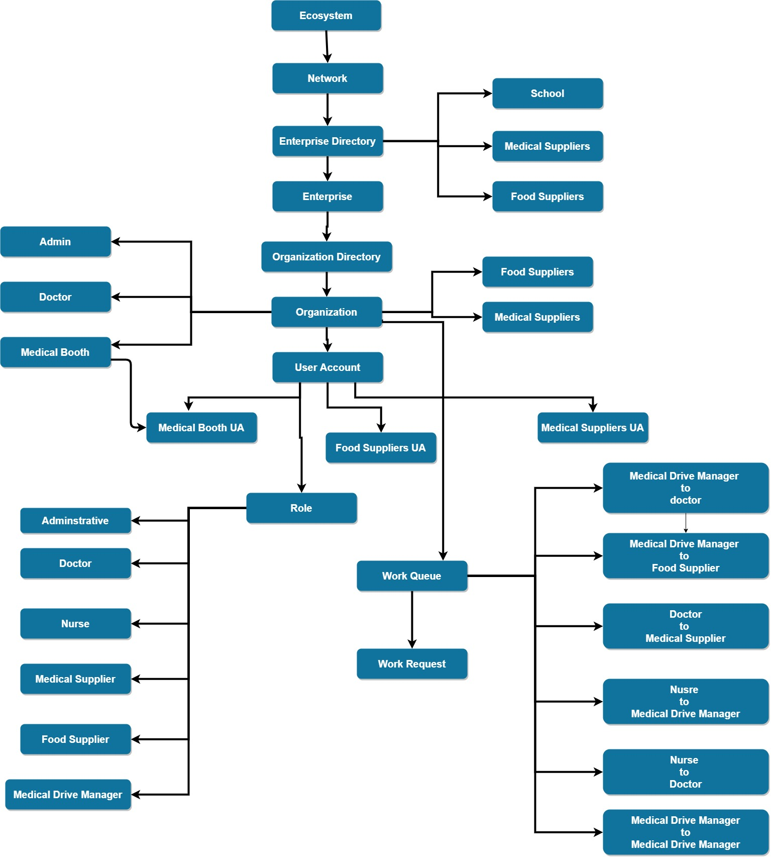
Object Model

Slide 8
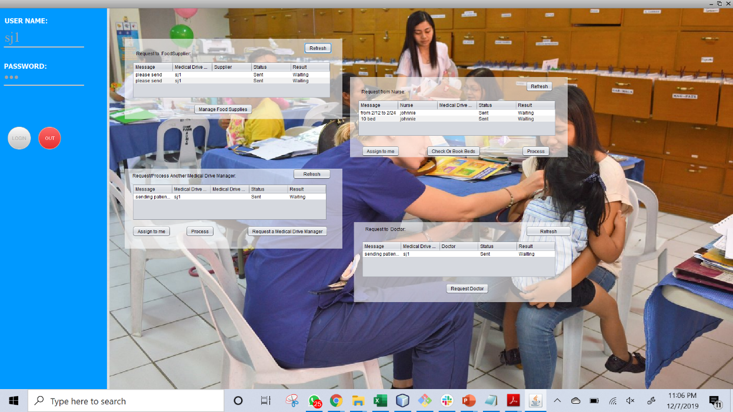
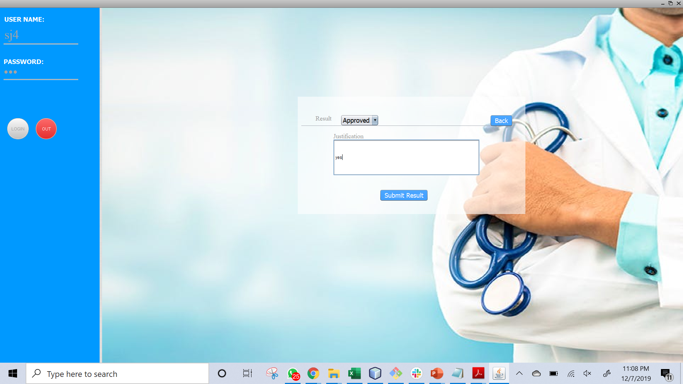
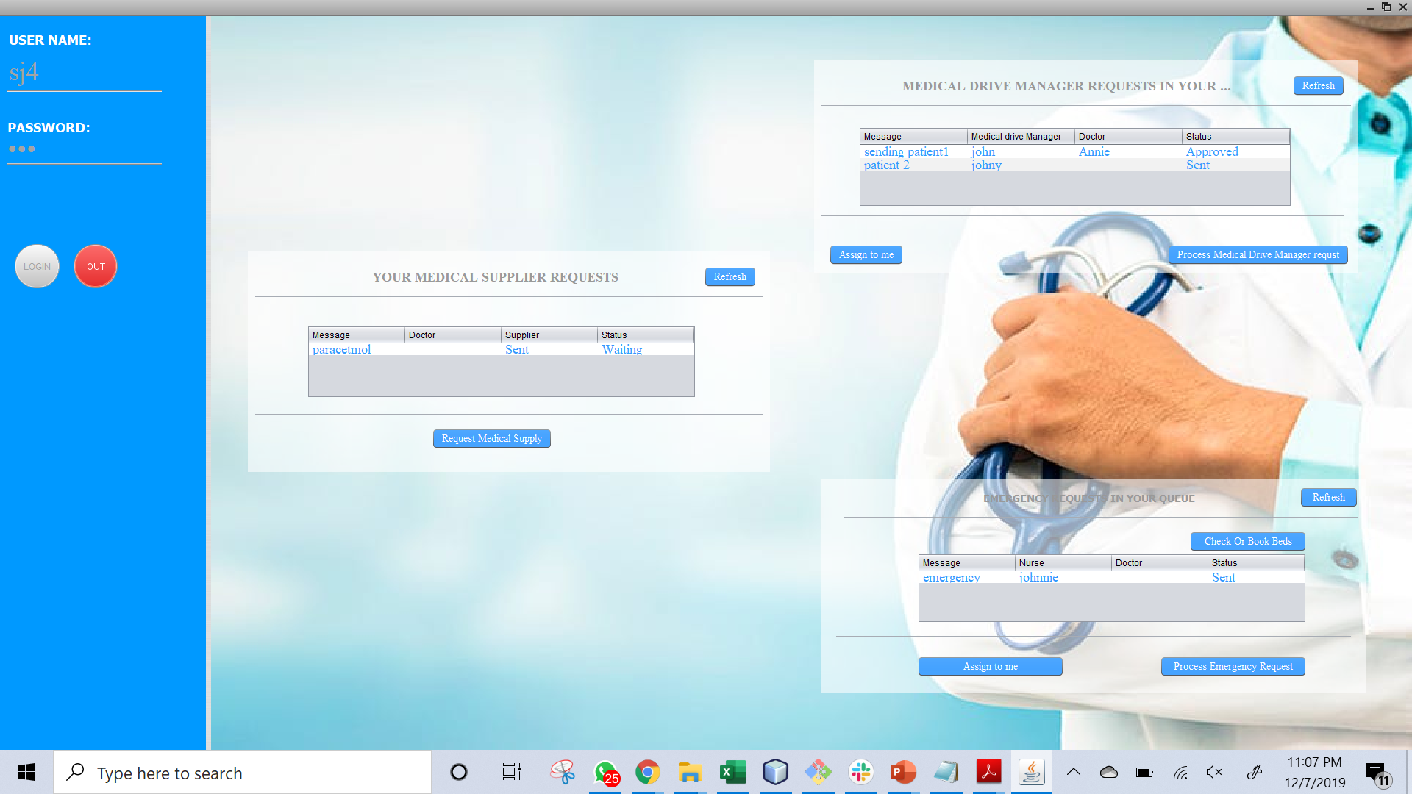
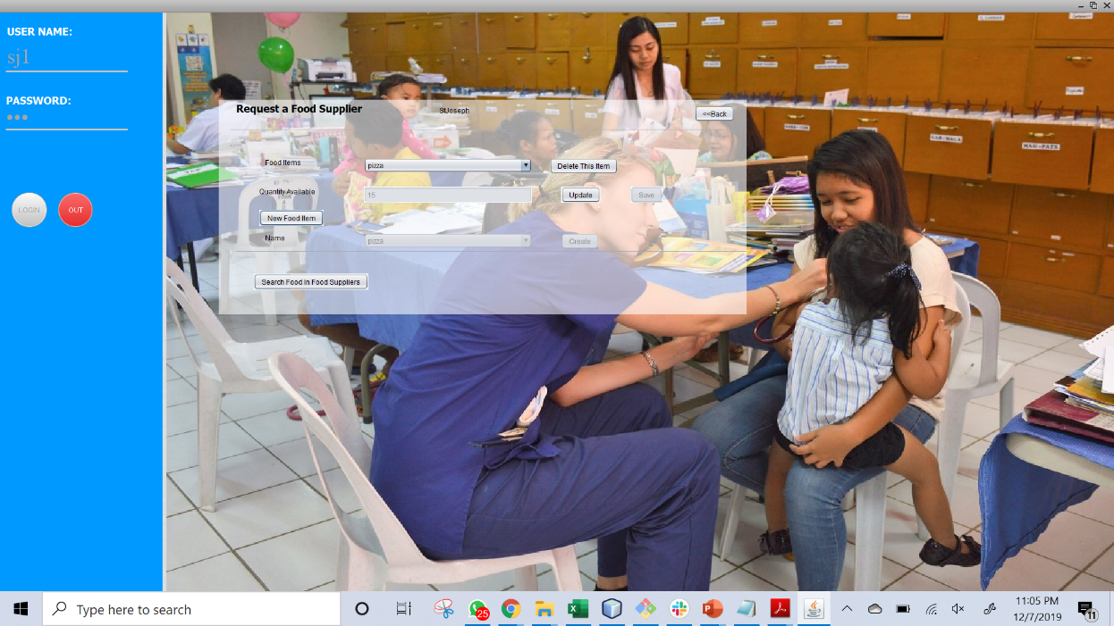
Medical Drive Manager To Doctor

Slide 9

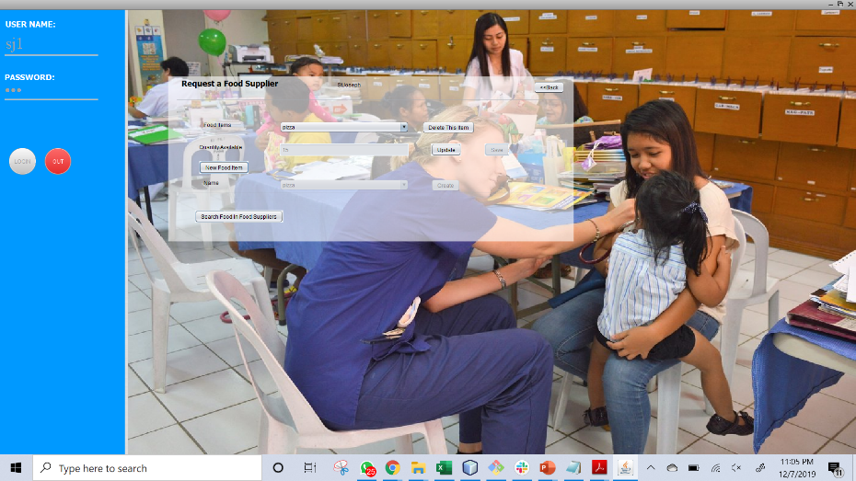
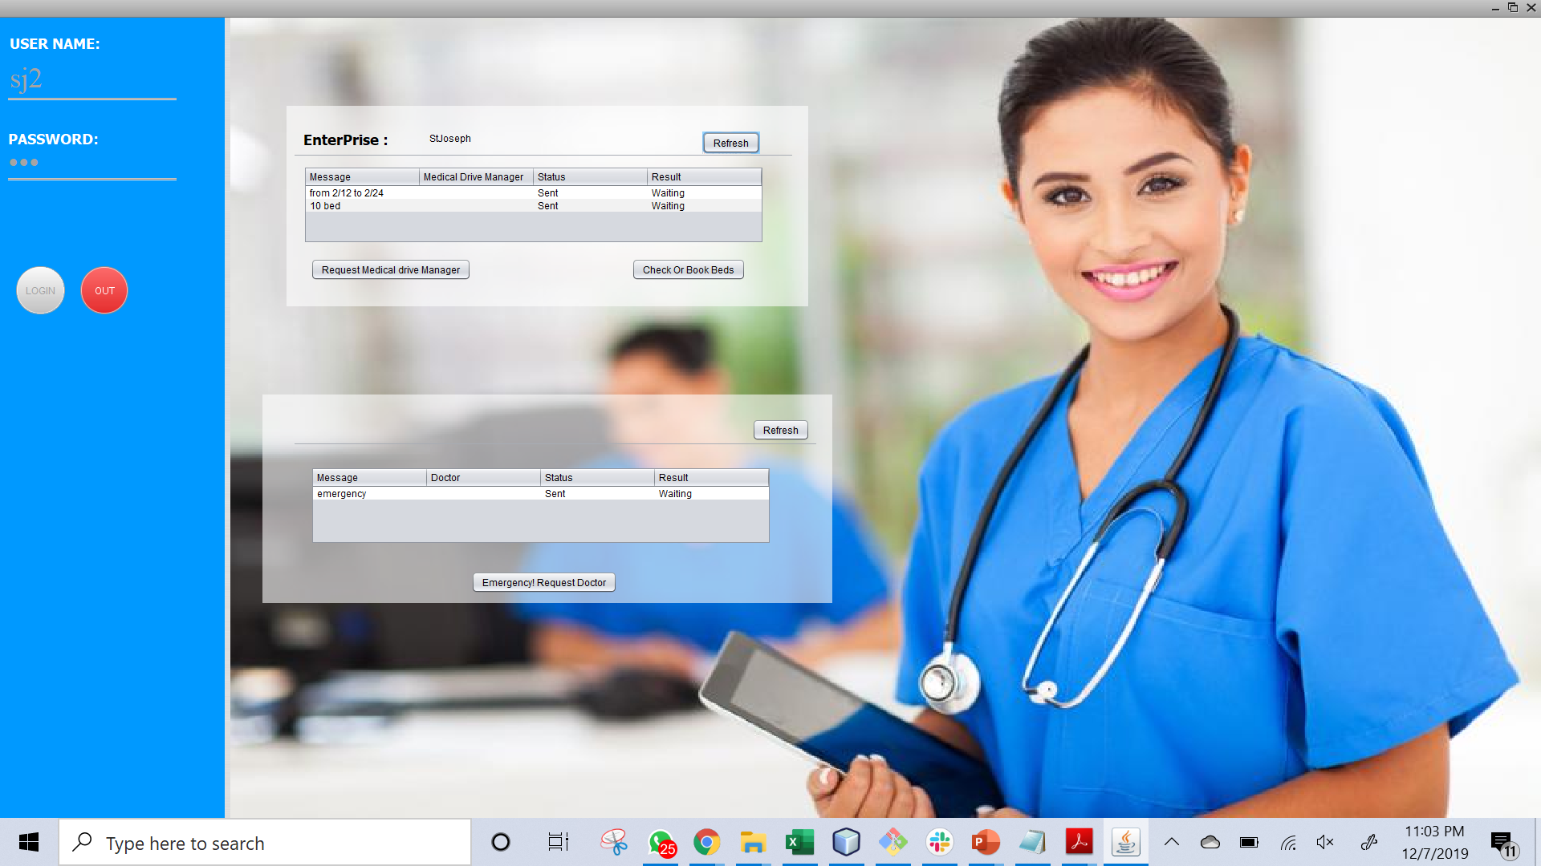
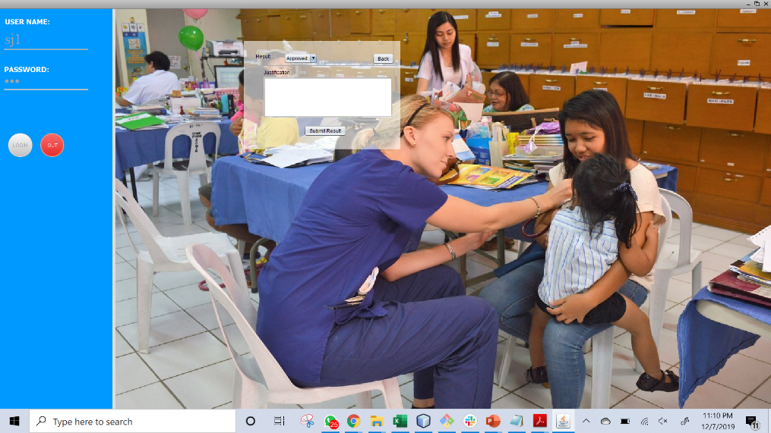
Nurse to medical Drive

Slide 10

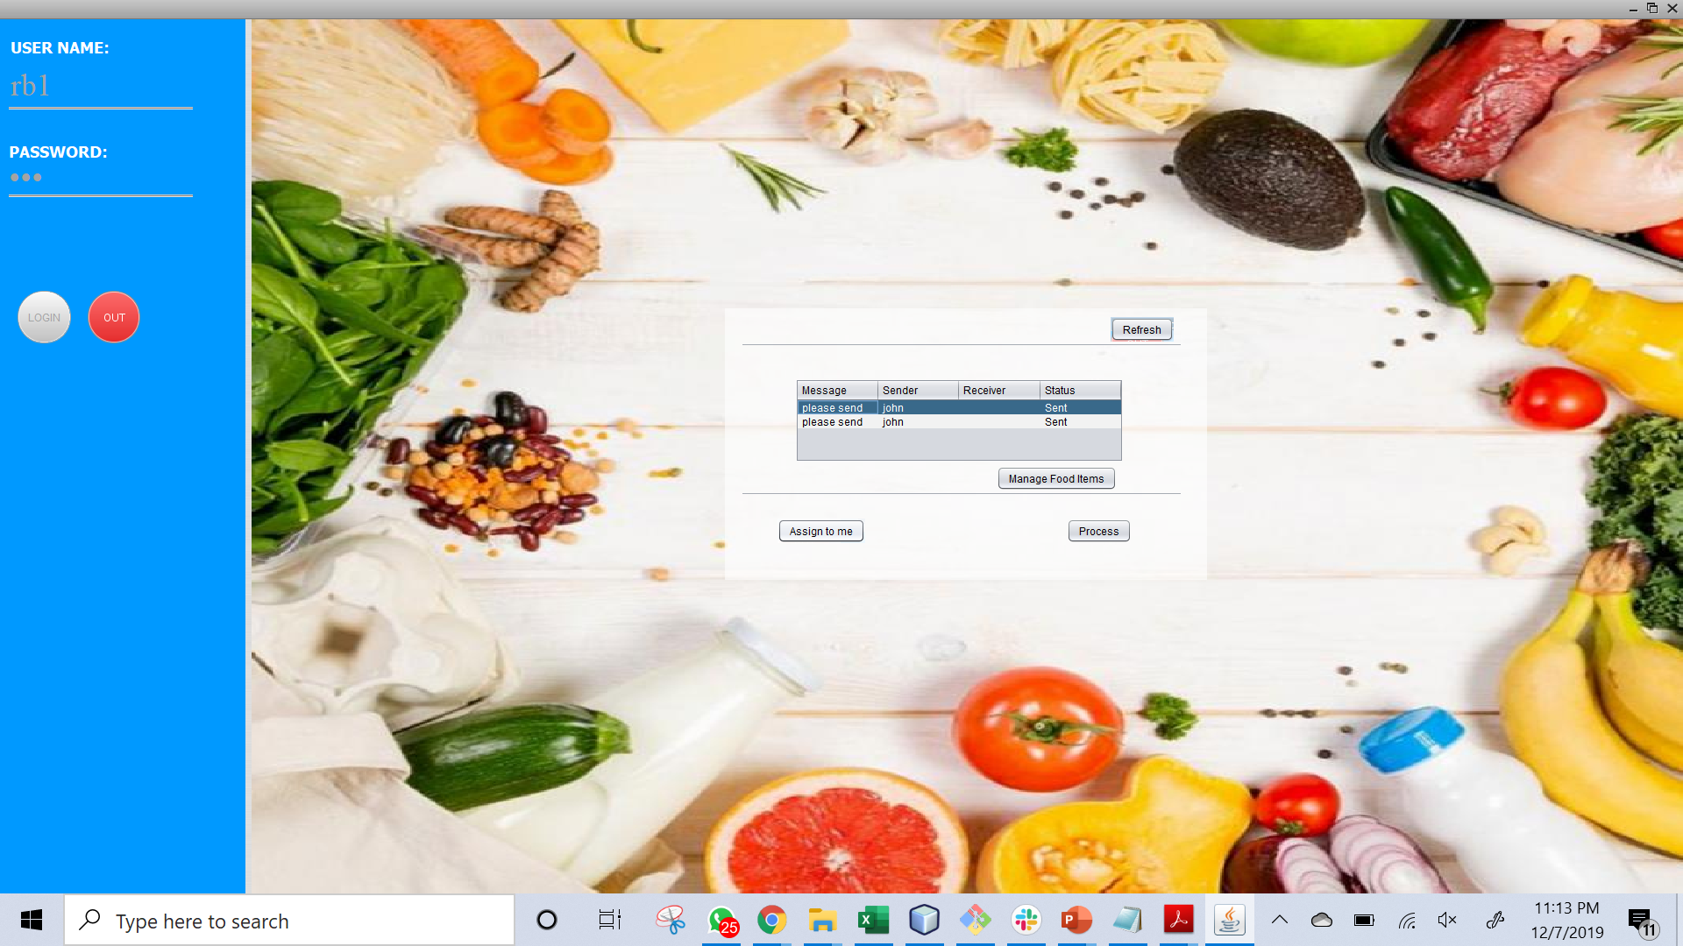
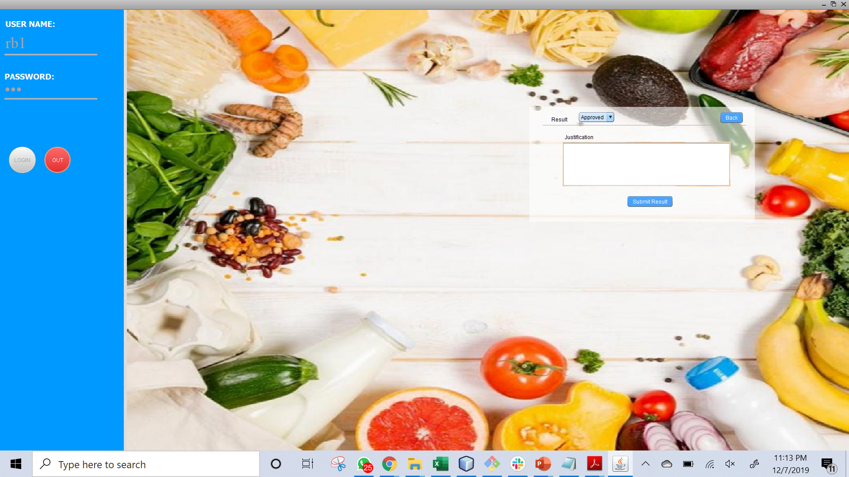
Medical Drive Manager to Food Supplier

Slide 11
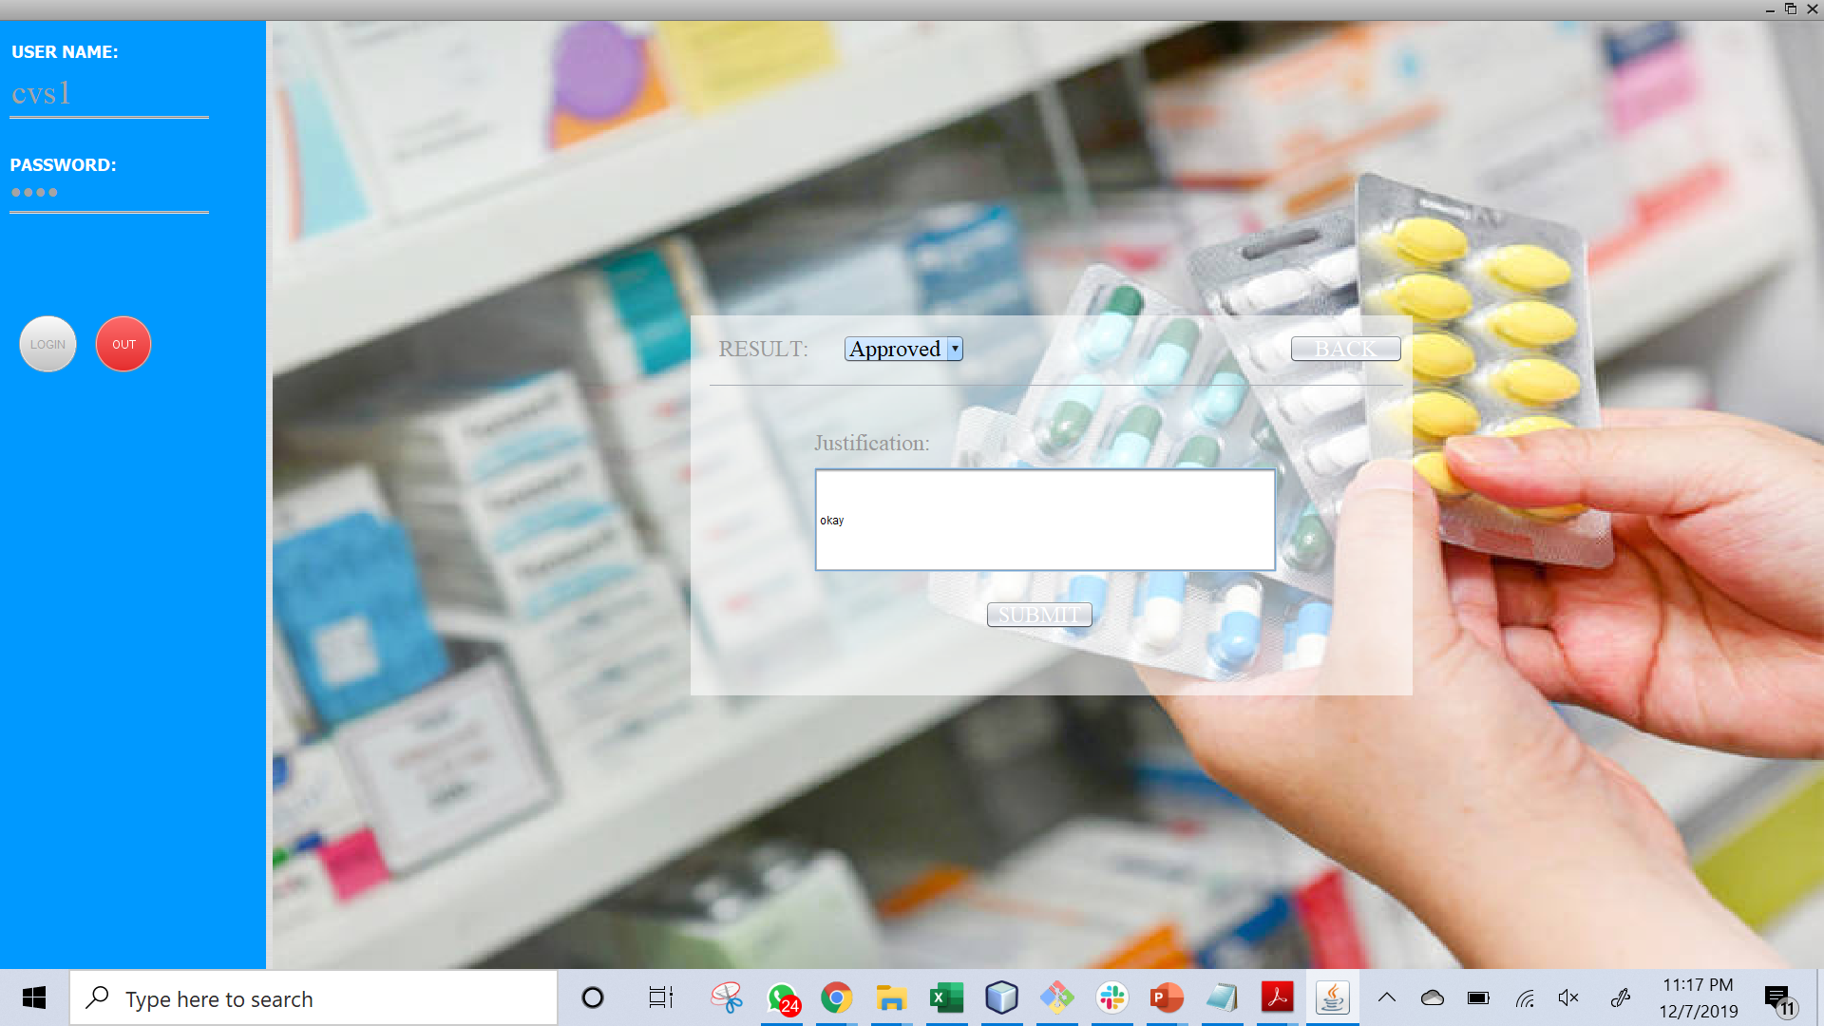
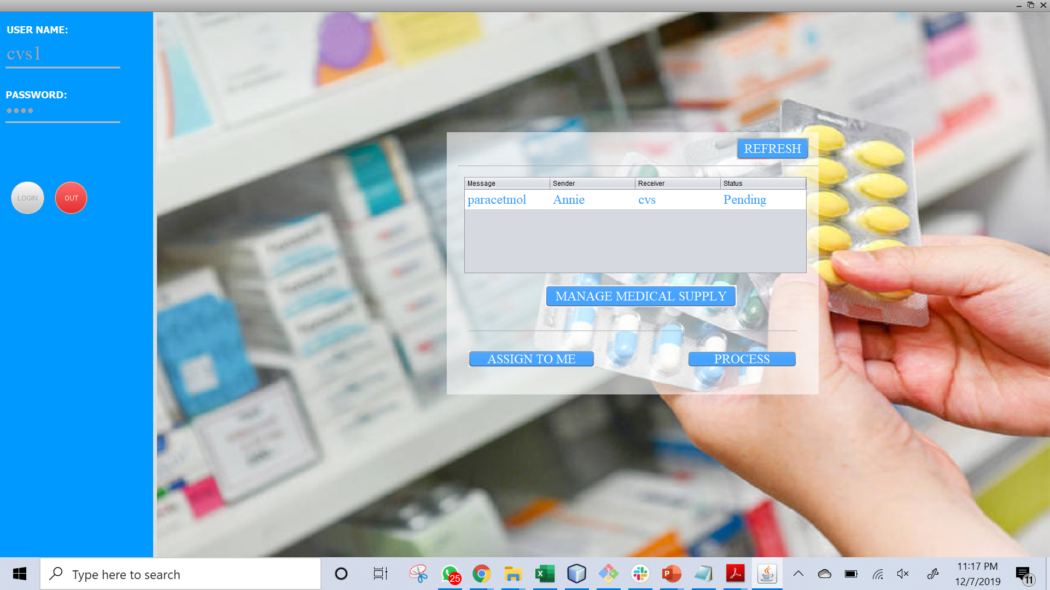
Doctor to Medical Supplier

Slide 12
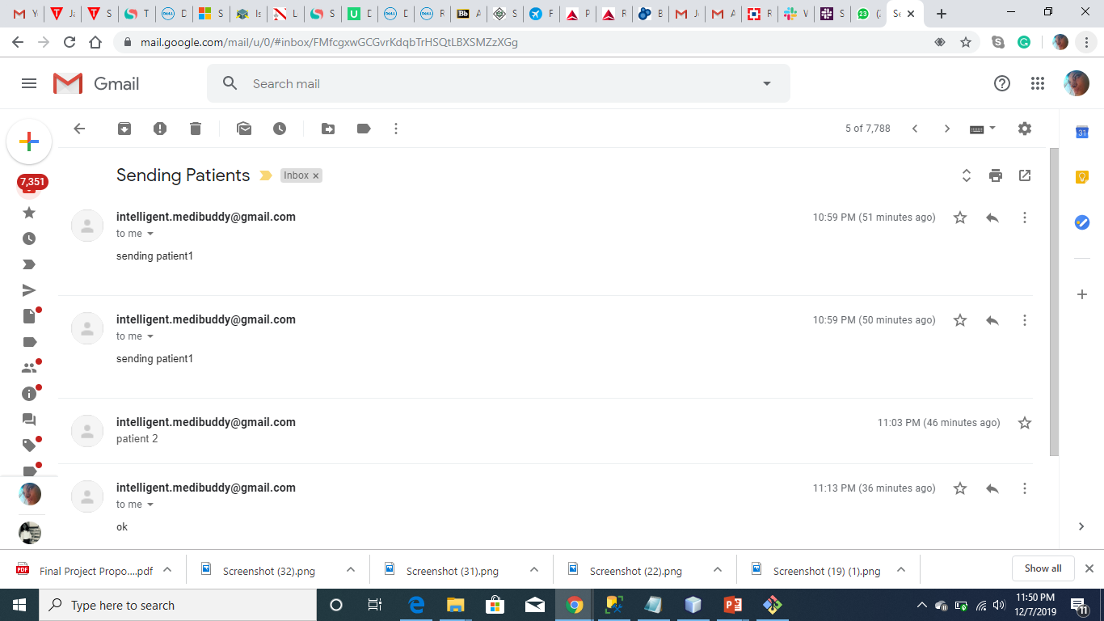
Funtionality

Slide 13
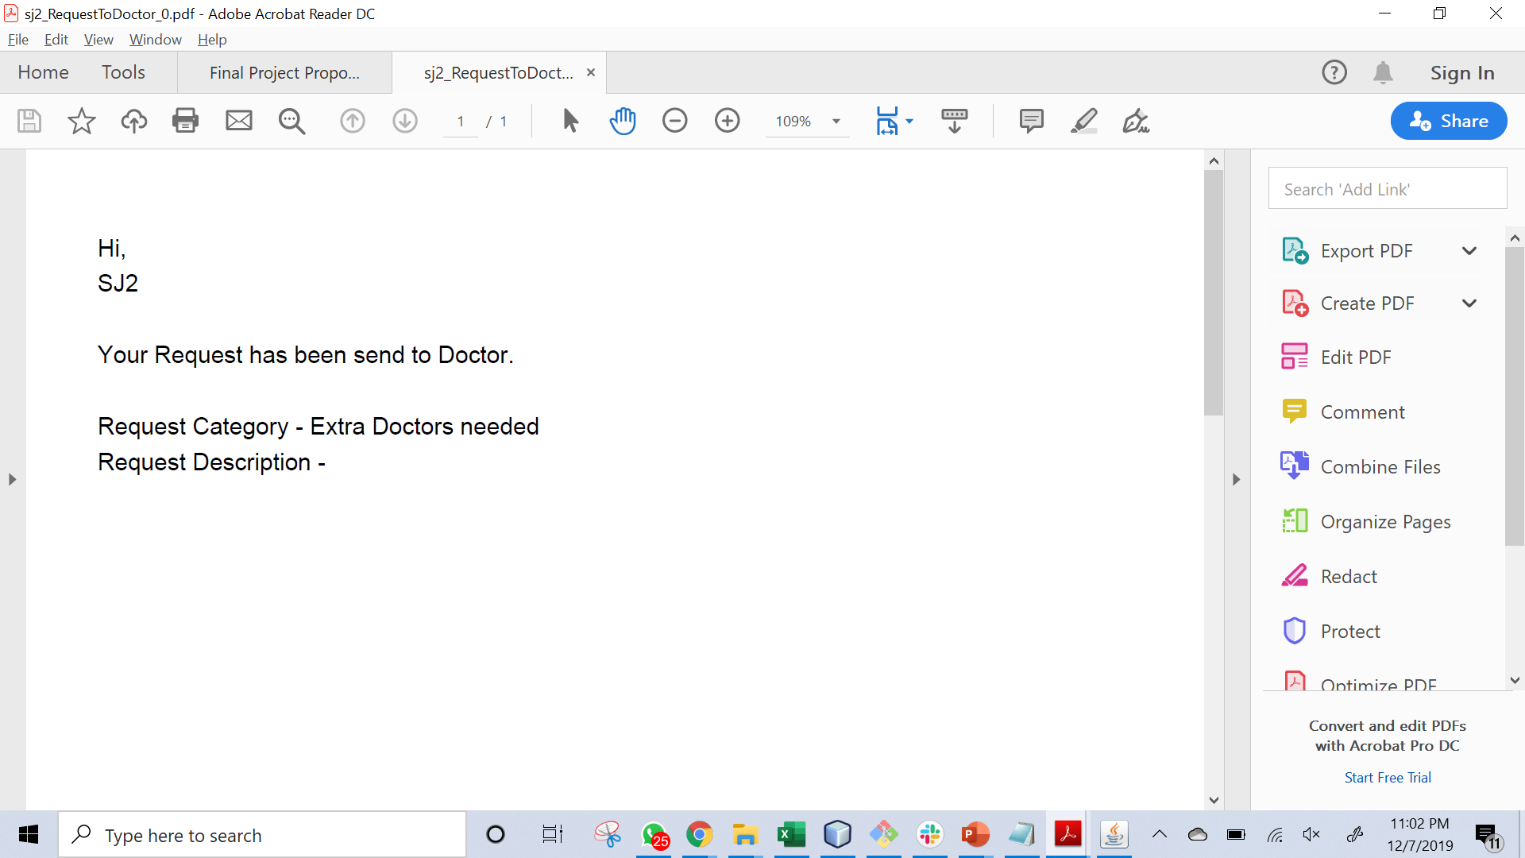
Funtionality

Slide 14
Thank You

